Slide 1





Spatial Stock Assessment Methods: International Approaches & Advancements
WEBINAR
An Introduction to the Project and Study Design
May 17, 2021
Working group: Caren Barceló (ECS Fed. in support of NOAA), Aaron Berger (NOAA), Jennifer Devine (NIWA), Alistair Dunn (Ocean Enviro.), Daniel Goethel (NOAA), Simon Hoyle (NIWA), Patrick Lynch (NOAA), Craig Marsh (UofA, NIWA), Jeremy McKenzie (NIWA), Sophie Mormede (SoFish)
Steering Committee: Paul DeBryun (IOTC), Rich Little (CSIRO) , Pamela Mace (NZ Fisheries), Mark Maunder (IATTC), Rick Methot (NOAA), Richard O’Driscoll (NIWA)

Slide 2
Webinar House Keeping
Please make sure you are muted (thanks!)
Please add questions to chat box & please be succinct!
There will be space for question/answer session in the middle & at the end of the presentation during which time you are welcome to unmute (when prompted).
Webinar is being recorded and provided to participants (along with slide deck) afterwards.
Github link: https://github.com/carenbarcelo-NOAA/Spatial-Assessment-Modeling-Workshop

Slide 3
Outline of Webinar
Objectives
General outline of experimental design
Plans for results (what is in it for you?)
Question & Answer (big picture Q’s)
Description of OM and datasets
SPM simulator background
Description of yellowfin tuna operating model
Datasets being provided to analysts
Github
Communication during experiment
Question & Answer

Slide 4
Spatial Stock Assessment Methods
A wide range of methods and assumptions can be applied to modeling spatial dynamics.
The assemblage of methods for modeling spatial dynamics in assessment packages is often linked to the species/situations encountered by the agency sponsoring the package
The spatial capabilities of software can affect analysts' decision-making, which may affect how analysts interpret population status.
There is currently little guidance about how to identify misspecification of spatial structure.

Slide 5
Objectives
Objective #1: Discuss best practices in spatial model development by exploring the decision-points an analyst encounters for each platform.
Objective #2: Evaluate within-platform performance and the impacts of different spatial configurations by comparing spatial and spatially aggregated models; and
Objective #3: Explore general performance across different categories of spatial models (e.g., non-spatial, spatially-implicit, spatially-stratified, and fully spatiotemporal) by comparing bias and precision across the broad categories. *No ranking of platforms!

Slide 6
Participating stock assessment platforms
Stock Assessment Platform or Model | Acronym
Metapopulation Assessment System | MAS
Globally Applicable Area-Disaggregated Ecosystem ToolBox | GADGET
Stock Synthesis 3 | SS3
Stock Synthesis with Areas-As-Fisheries | SS3 with FAA
C++ Algorithmic Stock Assessment Laboratory | CASAL
C++ Algorithmic Stock Assessment Laboratory (2nd generation) | CASAL2
MULTIFAN-CL | MFCL
Assessment For All | a4a
Spatial Processes And Stock Assessment Methods | SPASAM
Spatiotemporal Models | Cao et al.
Recapture Conditioned Models | -
Several Other Bespoke Models | -
*This is a working list that is subject to change.

Slide 7
Context
This simulation experiment is strictly a research endeavor, with the specific fish species chosen as an example to address broad study objectives.
*Research assessments from this workshop/experiment are not meant to directly inform operational management.*

Slide 8



Key Features
Simulation Experiment
Spring 2021 – Winter 2022
(Austral autumn 2021 – summer 2022)
[Q2 2021 – Q1 2022]
Your Seminar
Fall 2021 – Winter 2022
(Austral spring 2021 – summer 2022)
[Q4 2021 – Q1 2022]
Workshop (in person)
Spring 2022
(Autumn 2022)
[Q2 2022]

Slide 9

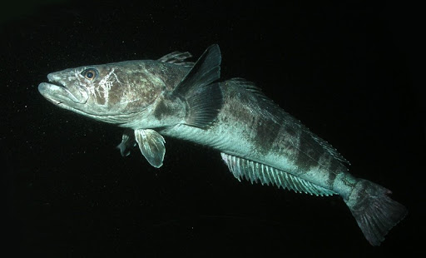
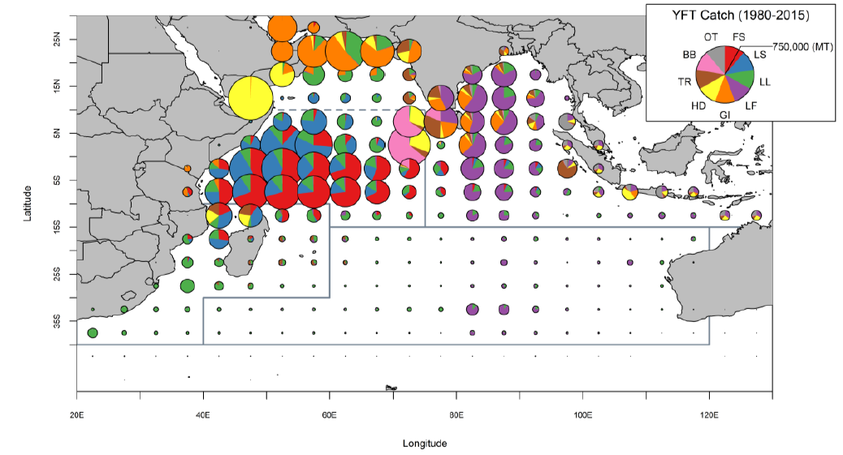
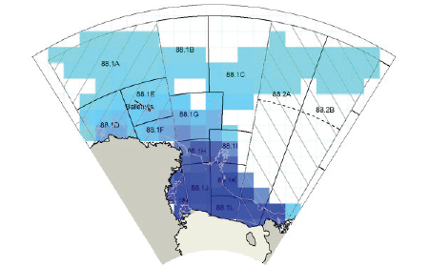
SPM-built Operating Models
Yellowfin Tuna
(YFT; Thunnus albacares)
Antarctic Toothfish
(AT; Dissostichus mawsoni)
wwf.org
Annual spatial movement
Ontogenetic spatial movement
Fu et al. 2018
Mormede et al. 2020

Slide 10
Simulation Experiment: Study Design
Step 1:
a) Set up assessment in platform of choice with single representative simulated dataset
b) Document decisions made
1 simulated dataset
Objective #1:
Document key decisions made

Slide 11
Simulation Experiment: Study Design
Step 2:
a) Run 100 total assessments through platform of choice
b) Provide standard stock assessment outputs (SSB time series, F, etc) for each of the 100 simulated datasets
Set up model with 1
dataset
Objective #1:
Document key decisions made
99 runs
100 Spatial Assessment Results
Fully spatial disaggregated (5x5 ̊ grid) simulated datasets available upon request
Observation Error: CPUE, Tagging and Length Frequencies
Recruitment stochasticity: Year class strength and spatial apportionment of recruitment

Slide 12
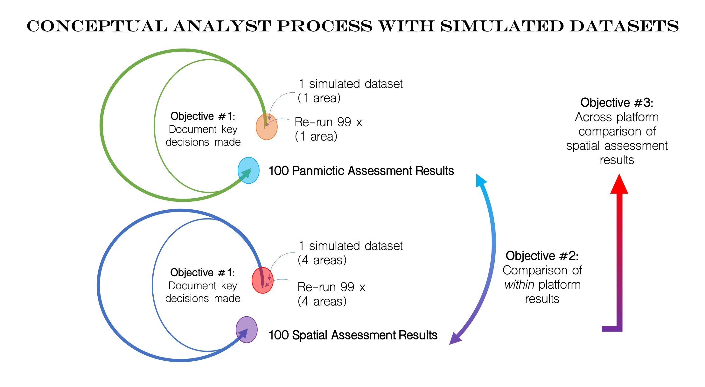
Simulation Experiment: Spatial Design
Spatial
R1
R4
R2
R3
*4 areas encouraged as based on areas defined in operational assessments
(alternate area aggregations also welcome)
Observation Error: CPUE, Tagging and Length Frequencies
Recruitment stochasticity: Year class strength and spatial apportionment of recruitment

Slide 13
Simulation Experiment: One Area Design
One area
R(1+2+3+4)
Observation Error: CPUE, Tagging and Length Frequencies
Recruitment stochasticity: Year class strength and spatial apportionment of recruitment

Slide 14
Simulation Experiment: (Base) Study Design
* By assessment approach, across model categories

Slide 15
Compiling Results: Requests of Analysts
Standard set of assessment outputs (1 & 4 Area results)
Analysts encouraged to explore alternate aggregations/model parameterizations, time permitting
Decision point analysis
How did model spatial functionality influence decisions?
Model diagnostics
How were diagnostic tools used to determine spatial parametrization?
Summary statements given your results
Seminar presentation of results

Slide 16
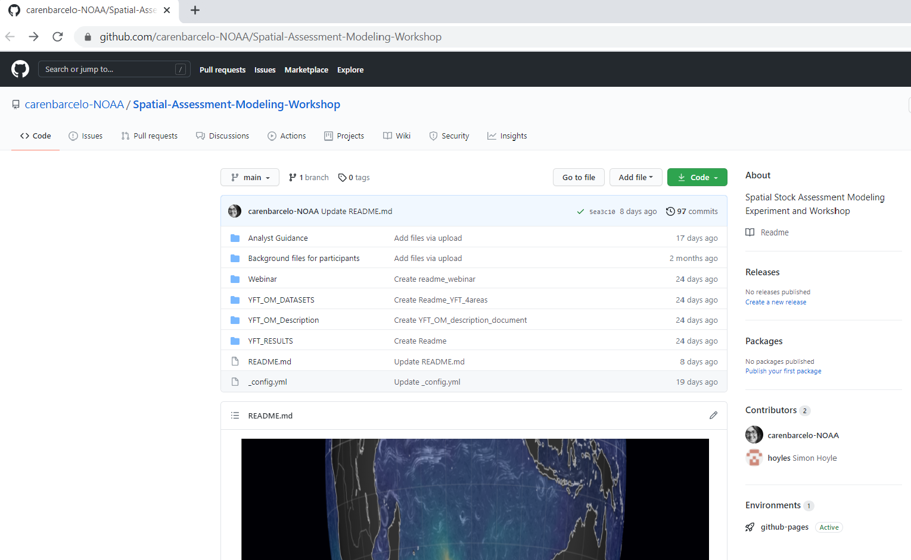
Github site
https://github.com/carenbarcelo-NOAA/Spatial-Assessment-Modeling-Workshop
Project overview
Retrieve important files and background material
Retrieve simulation data (once available)
Participants can email organizers &/or use Github issues/team discussions

Slide 17
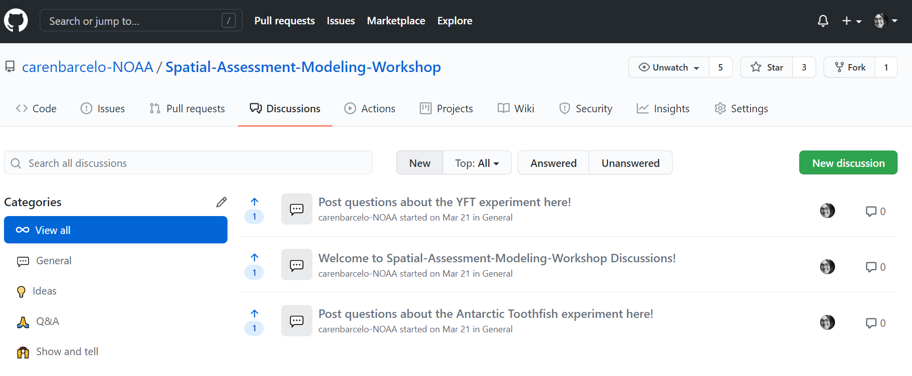


Communication (will be key!)
GITHUB handle: carenbarcelo-NOAA
Email organizers at any time for individual needs
Github Team Discussions

Slide 18
Communication (will be key!)
Email organizers at any time for individual needs
(caren.barcelo@noaa.gov)
Github Team Discussions (during experiment)
Follow up webinars (data details, Q&A with analysts)
Platform-specific teams – coordination/collaboration is encouraged

Slide 19
Seminars: A Discussion Forum for Your Results
90 minute ‘workshop style’ seminar of simulation results for each analyst/analyst group
45 to 60 minute virtual presentation by each analyst group (or platform group)
30 to 45 minute question and answer and discussion amongst all simulation and guest participants
Best practices/future needs discussion
Seminars will be public and are intended to elicit feedback and discussions on decision point analysis, model diagnostics, and within model comparisons.

Slide 20
Plans for Experiment Synthesis
Organizers
Organizers: Organize and compile information from each assessment platform
Organizers: Synthesize differences and similarities among model types and across panmictic v. spatial assessment results & summary workshop report.
All (analysts & organizers)
All: Collaboratively develop peer-reviewed workshop synthesis manuscript(s)
All those who actively participated in the simulation experiment (and are interested/have time) will be invited to be co-author on synthesis manuscript(s).

Slide 21
Plans for In-Person Workshop 2022
Discussion of best practices when developing spatial models
When (TBD; ~ this time 2022)
Where (Details TBD)
Useful for best practices discussions
@ CAPAM 2022

Slide 22
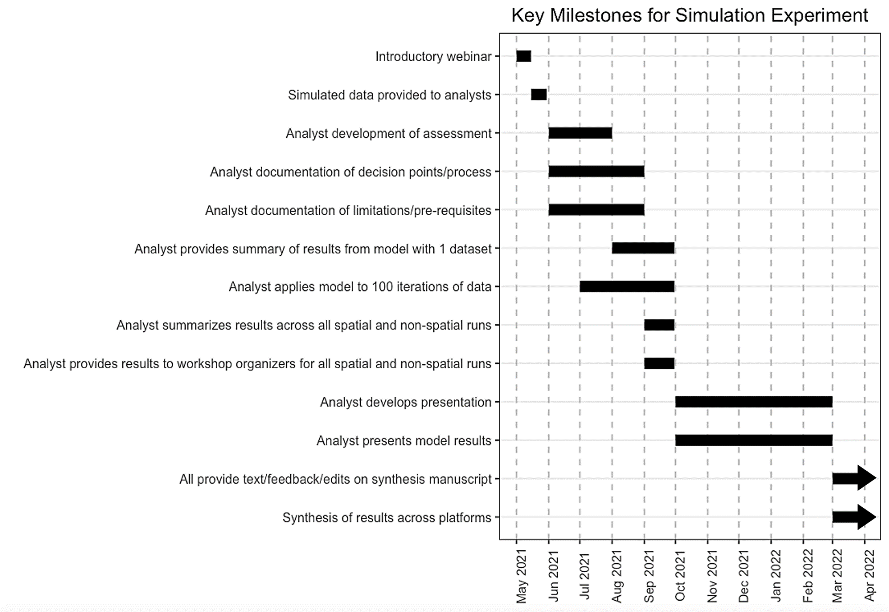
Flexible Timeline
Timeline developed to be flexible to individual needs
General plan for in-person workshop

Slide 23
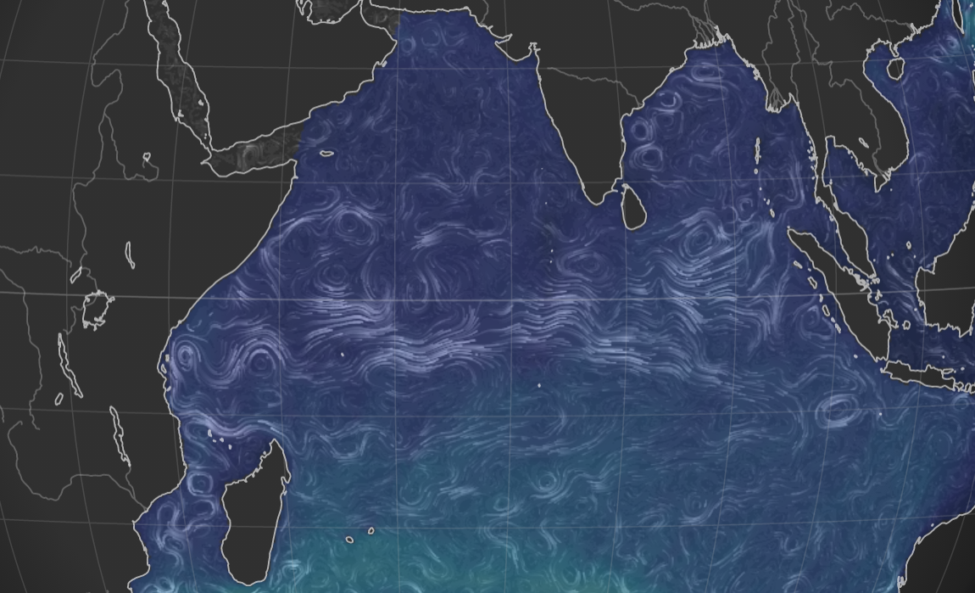
Brief (big picture) clarifying questions?

Slide 24

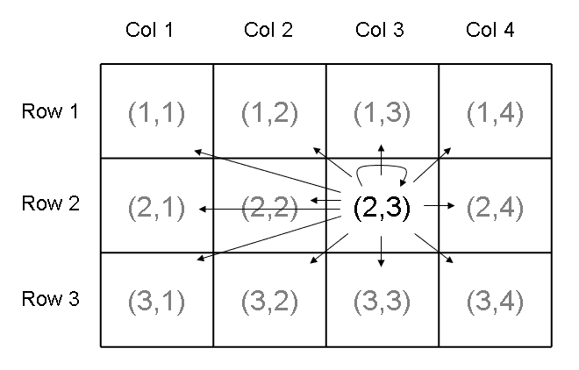
Brief SPM Overview
https://github.com/alistairdunn1/SPM
Developed at NIWA in mid-2000s to investigate biases with the use of tagging data for the assessment of Antarctic Toothfish in the Ross Sea
Written in C++. Source code is on GitHub
Allows generalized space-time structures, with a range of observation and process types and can:
Estimate a wide range of free parameters
Profile, point estimates, and MCMC using Maximum Likelihood and Bayes
Simulate observations from a given set of parameters and model structure
Dunn, A.; Rasmussen, S.; Mormede, S. (2020). Spatial Population Model User Manual, SPM 2.0.3-2020-08-29.
Ocean Environmental Technical Report. Ocean Environmental Ltd. Wellington, New Zealand. 235 p.

Slide 25
SPM-built Operating Models
Yellowfin Tuna (YFT; Thunnus albacares)
Fu et al. 2018
wwf.org
Details coming soon!
Antarctic Toothfish (AT; Dissostichus mawsoni)

Slide 26
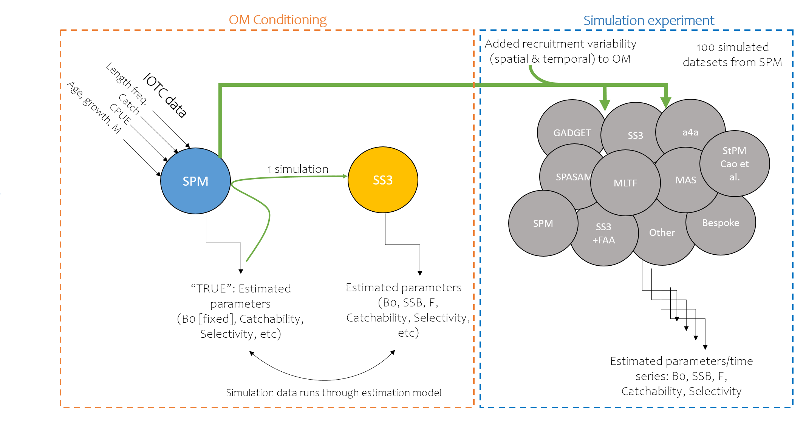
YFT OM & Simulation Set-up
wwf.org

Slide 27
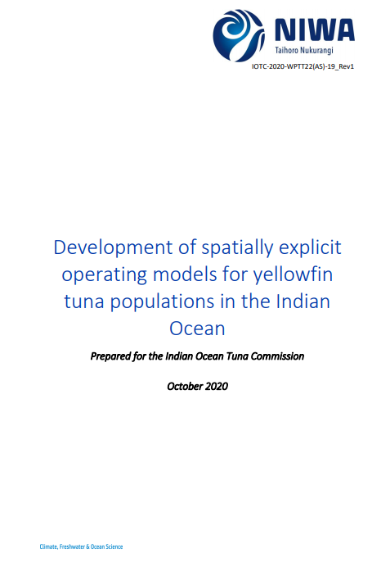

YFT OM & Simulation Set-up
wwf.org
Alistair Dunn,
Simon Hoyle,
Samik Datta

Slide 28
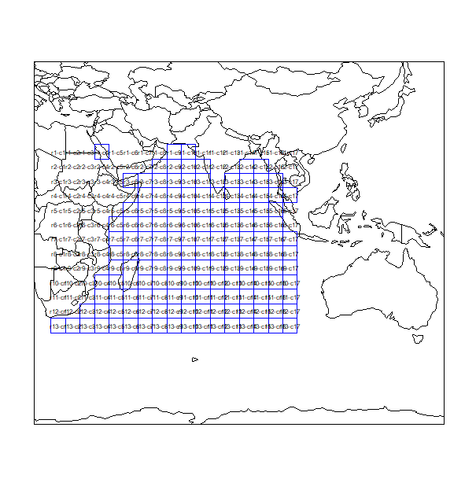
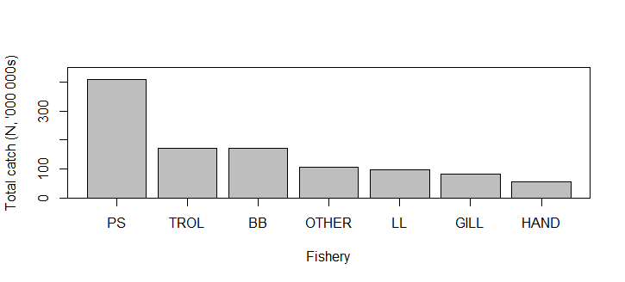
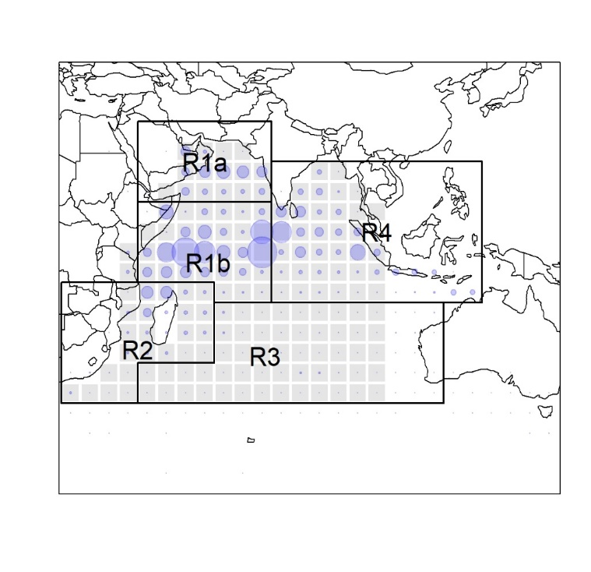
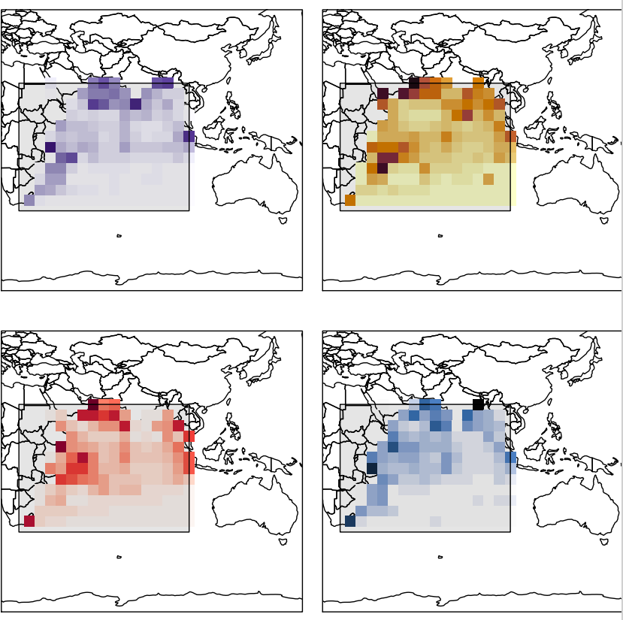
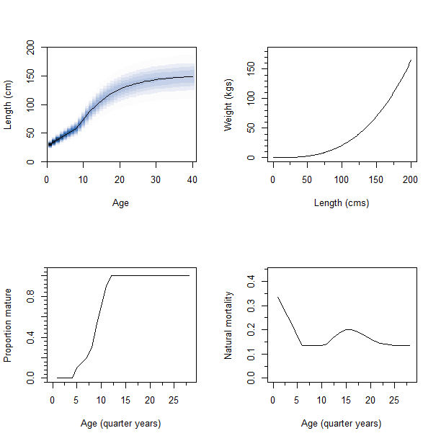
YFT OM: Structural Overview
Fishing
Spatially Explicit Layers
7 ‘fisheries’ (by gear type)
* Fisheries not by country, just by gear type (6 fisheries + 1 ‘Other’ fishery category)
Parametric shape of selectivity for each fleet provided
R1
Biology
Spatial structure provided and based upon dynamics and data at 5x5 grid cells
Biological parameters provided

Slide 29
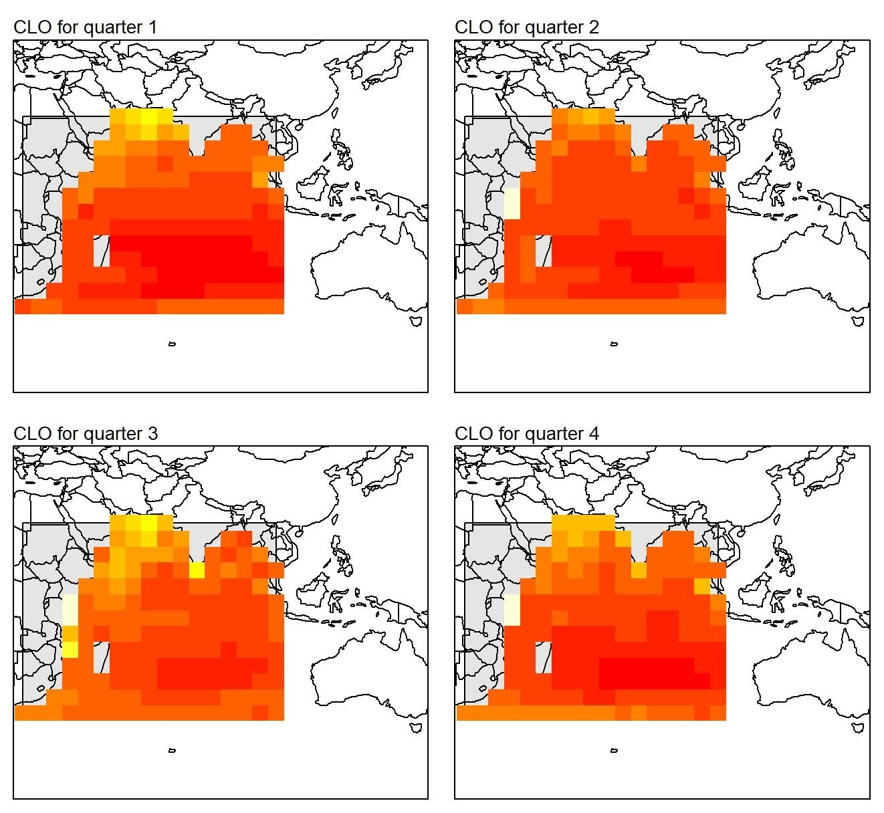
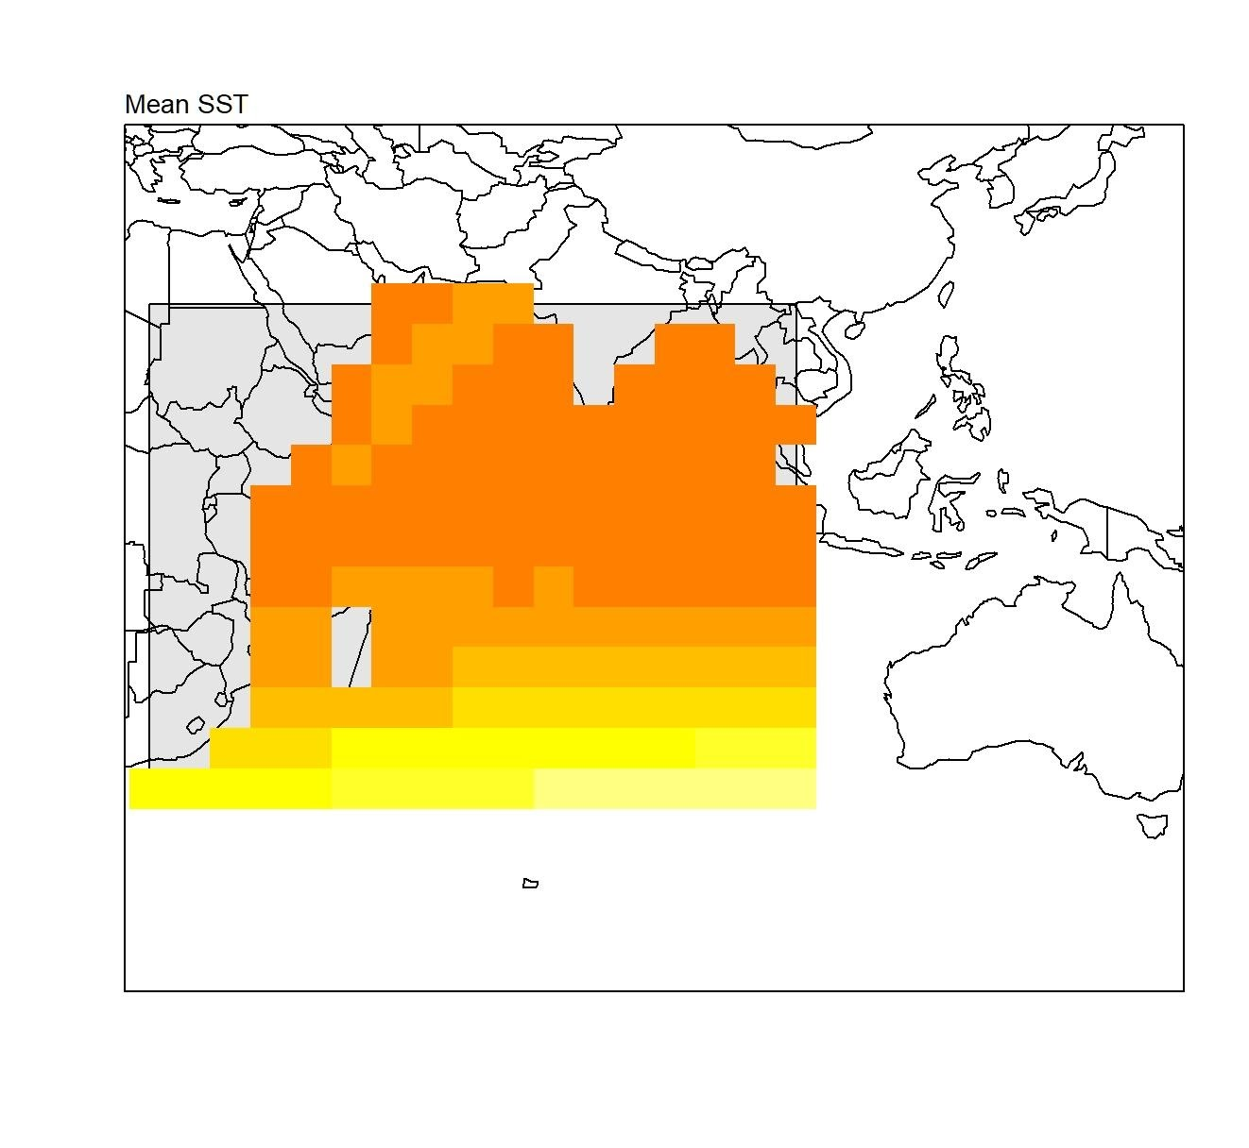
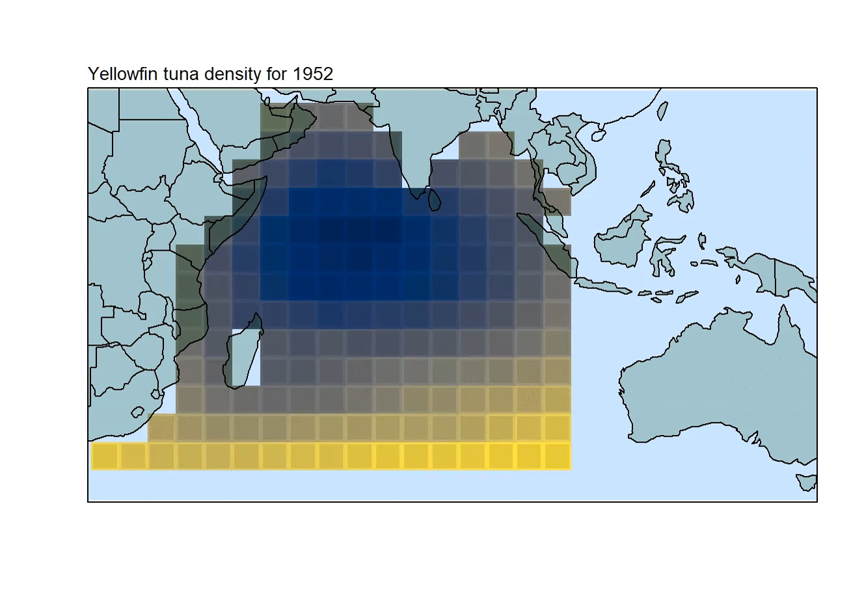
YFT OM: Structural Overview
Movement
Habitat based preference functions by age group
mature or
immature
Chlorophyll-a
Sea surface temperature
& Linear distance between locations
Preference functions used to model movement

Slide 30
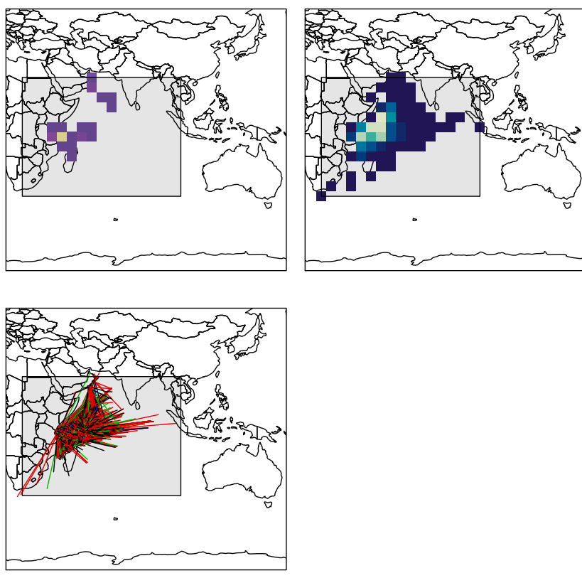
YFT OM: Data Sources
&
One Area
Spatial
Catch by fleet and area
Standardized CPUE indices for
Pelagic Longline fleet by area
Length compositions by fleet and area
Tagging data (mark-recovery)
Observation Error: NONE (assumed precise known catch from simulation)
Not by country, but different gear types (PS, LL, etc)
Observation Error: Simulation lognormal likelihood CV =0.2. Standardized & regionally weighted by abundance following Hoyle & Langley (2020)
Observation Error: Simulation binomial likelihood
Observation Error: Simulation multinomial likelihood

Slide 31
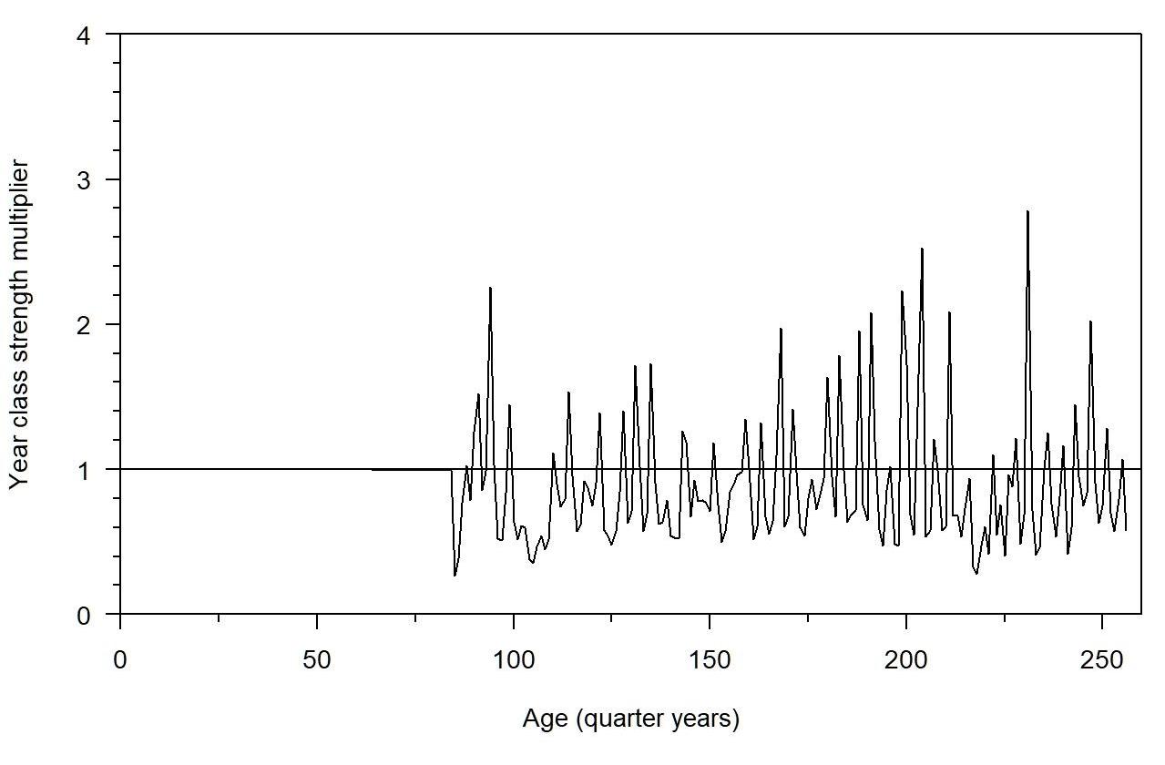
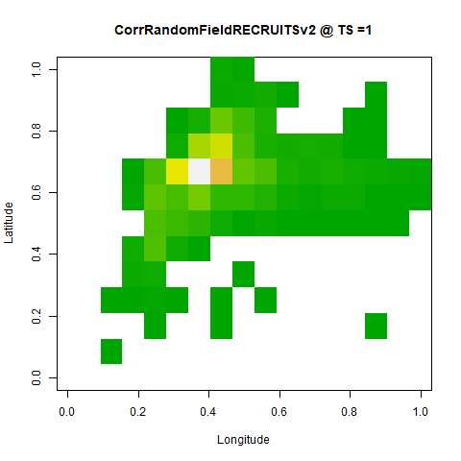
YFT OM: Structural Overview
Incorporated recruitment stochasticity (spatial & temporal)
Temporal stochasticity in recruitment:
Log normally distributed recruitment deviations Generated 100 replications of 256 time steps (quarters)
Spatial stochasticity in average recruitment apportionment:
Gaussian correlated random fields
Generated 100 grid replications for each of the 256 model time steps (quarters)

Slide 32
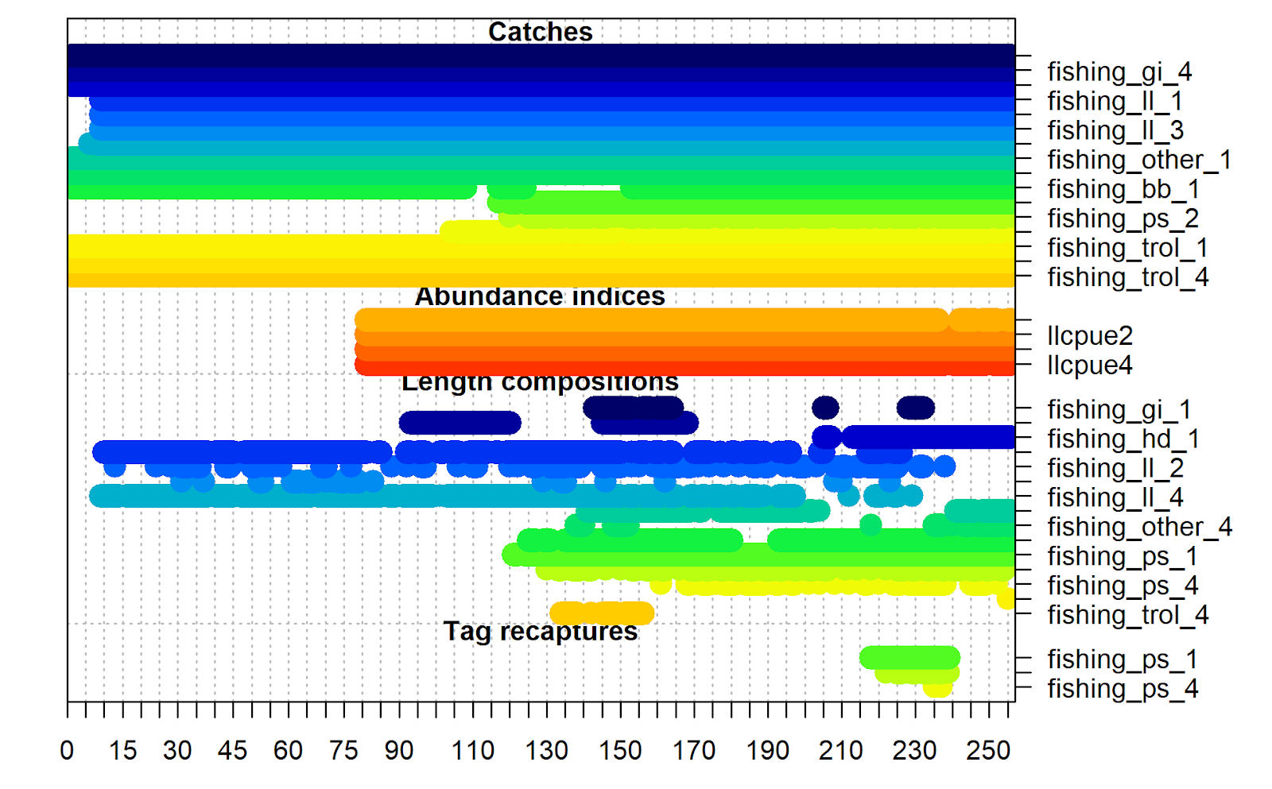
Data file formats
Well commented text files
Files will generally follow, or be similar to,
stock synthesis input data.ss / .Rdata
Reach out for clarifications or assistance!
Model time steps - quarters
Also, please reach out to the organizers if you would like the data in other aggregations/ways and we can work with you!

Slide 33
Objectives
Objective #1: Discuss best practices in spatial model development by exploring the decision-points an analyst encounters for each platform.
Objective #2: Evaluate within-platform performance and the impacts of different spatial configurations by comparing spatial and spatially aggregated models; and
Objective #3: Explore general performance across different categories of spatial models (e.g., non-spatial, spatially-implicit, spatially-stratified, and fully spatiotemporal) by comparing bias and precision across the broad categories. *No ranking of platforms!

Slide 34
Flexible Timeline
Timeline developed to be flexible to individual needs
General plan for in-person workshop

Slide 35
Thank you! Please email us if you have any questions/comments/concerns. Email: caren.barcelo@noaa.gov We look forward to working with you!
Working group | Steering Committee
Caren Barceló (ECS in support of NOAA) Aaron Berger (NOAA) Daniel Goethel (NOAA) Simon Hoyle (NIWA) Alistair Dunn (Ocean Environmental, LLC) Patrick Lynch (NOAA) Jeremy McKenzie (NIWA) Jennifer Devine (NIWA) Craig Marsh (NIWA) | Pamela Mace (Fisheries NZ) Mark Maunder (IATTC) Rick Methot (NOAA) Rich Little (CSIRO) Paul DeBruyn (IOTC/FAO) Richard O’Driscoll (NIWA)

Slide 36
General questions/comments

